Slide 1


CPCESU Project Management System
Design Review 1
+
Joseph Remy [Team Lead], Colton Nunley, Jasque Saydyk
Faculty Mentor: Ana Paula Chaves Steinmacher
Notes:
[Colton]
15 seconds
Questions for presentation:
Gantt chart, show to end of project or is current fine? Or have another with a much bigger view of project with just milestones, then

Slide 2
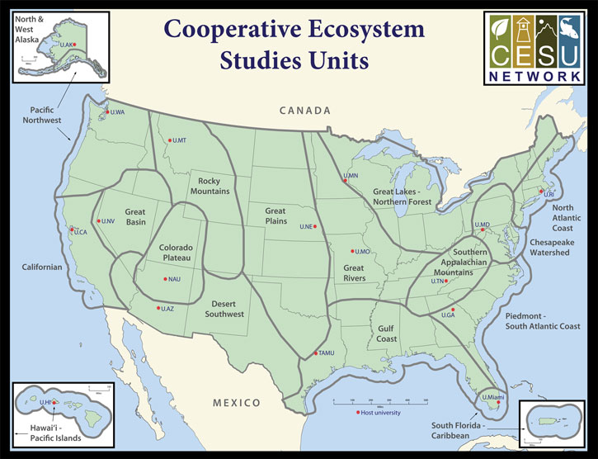
Colorado Plateau Cooperative Ecosystem Studies Unit
CPCESU is a part of a national consortium for resource stewardship
Dozens of projects
Hundreds of modifications
Millions of dollars
Notes:
[Colton]
30 seconds
Hook/Big picture
Nature is very important part of who we are as humans. It is our foundational responsibility to be stewards of mother nature. This planet is our home...
CPCESU
The Colorado plateau fosters this love and stewardship by supporting and maintaining ecological projects across the SW. They act as an intermediary between various Federal and non federal agencies to provide project projection and statistics as well as maintain current projects with what they refer to as ‘modifications’.
Specifics
To do this, the Colorado Plateau gets dozens of project proposals, hundreds of modifications, and millions of dollars each year to setup, organize, fund, track, and archive these projects. They accomplish this by utilizing data from past projects. Their current project management system is hindering their ability to work effectively.
The CPCESU is a government agency which organizes federal agencies and Native, state, and local governments with non-governmental organizations and universities to complete a variety of conservation projects from investigating archeology sites to conducting zoological surveys.
All of this helps preserve the nature and history of the Amercian Southwest, allowing us to learn more about the impacts we have our fragile ecosystem<move up wide to specfic>
To do this, the CPCESU gets dozens of project proposals, hundreds of modifications, and millions of dollars each year to setup, organize, fund, track, and archive these projects.
Which is common thing for organizations to do, and each organization is going to have their own system to manage their projects, whether it’s formalized or not
The CPCESU is a part of a national consortium that is focused on assisting organizations, like the National Park Service and the Bureau of Land Management, draft projects to be done by university professors and students, connecting these organizations with subject matter experts if need be, and providing a legal contract stating how these projects are to be completed, tracking these projects until they are completed, and transferring the funding for these projects over from the organization to the budget for the project.
This is something that a bunch of organizations do, make take projects, assign them, and track them throughout their lifetime, given them a budget to work with, and each of their management schemes cater their particular needs and niches. Even we in software dev use other tools to help us track the projects we are working on
Old Rough Slide content:
Colorado Platue Coorperative Ecosystem Studies UnitIn they help connect federal agencies and organizations that want to have a project that does a ecological studies etc, with experts for various projects and connect them, establishes a contract between the two, distributes funds accordingly, and tracks the project throughout it’s life
CPCESU:
The CPCESU is a derivative of the CESU which a national organization which is spread among many different biogeographical areas of the US. The CPCESU is hosted by NAU with Dr. Todd Chaudhry as the Research Coordinator and Laurie Thom as the Program Coordinator. They are going to be the main users for our end product. Both of them help many different federal agencies come up with a viable ecological project plans based on past project experience and statistics. The Colorado Plateau helps other federal agencies work on ecological projects. Whether that's studies, help building and maintaining a trail, or ecological investigations.

Slide 3



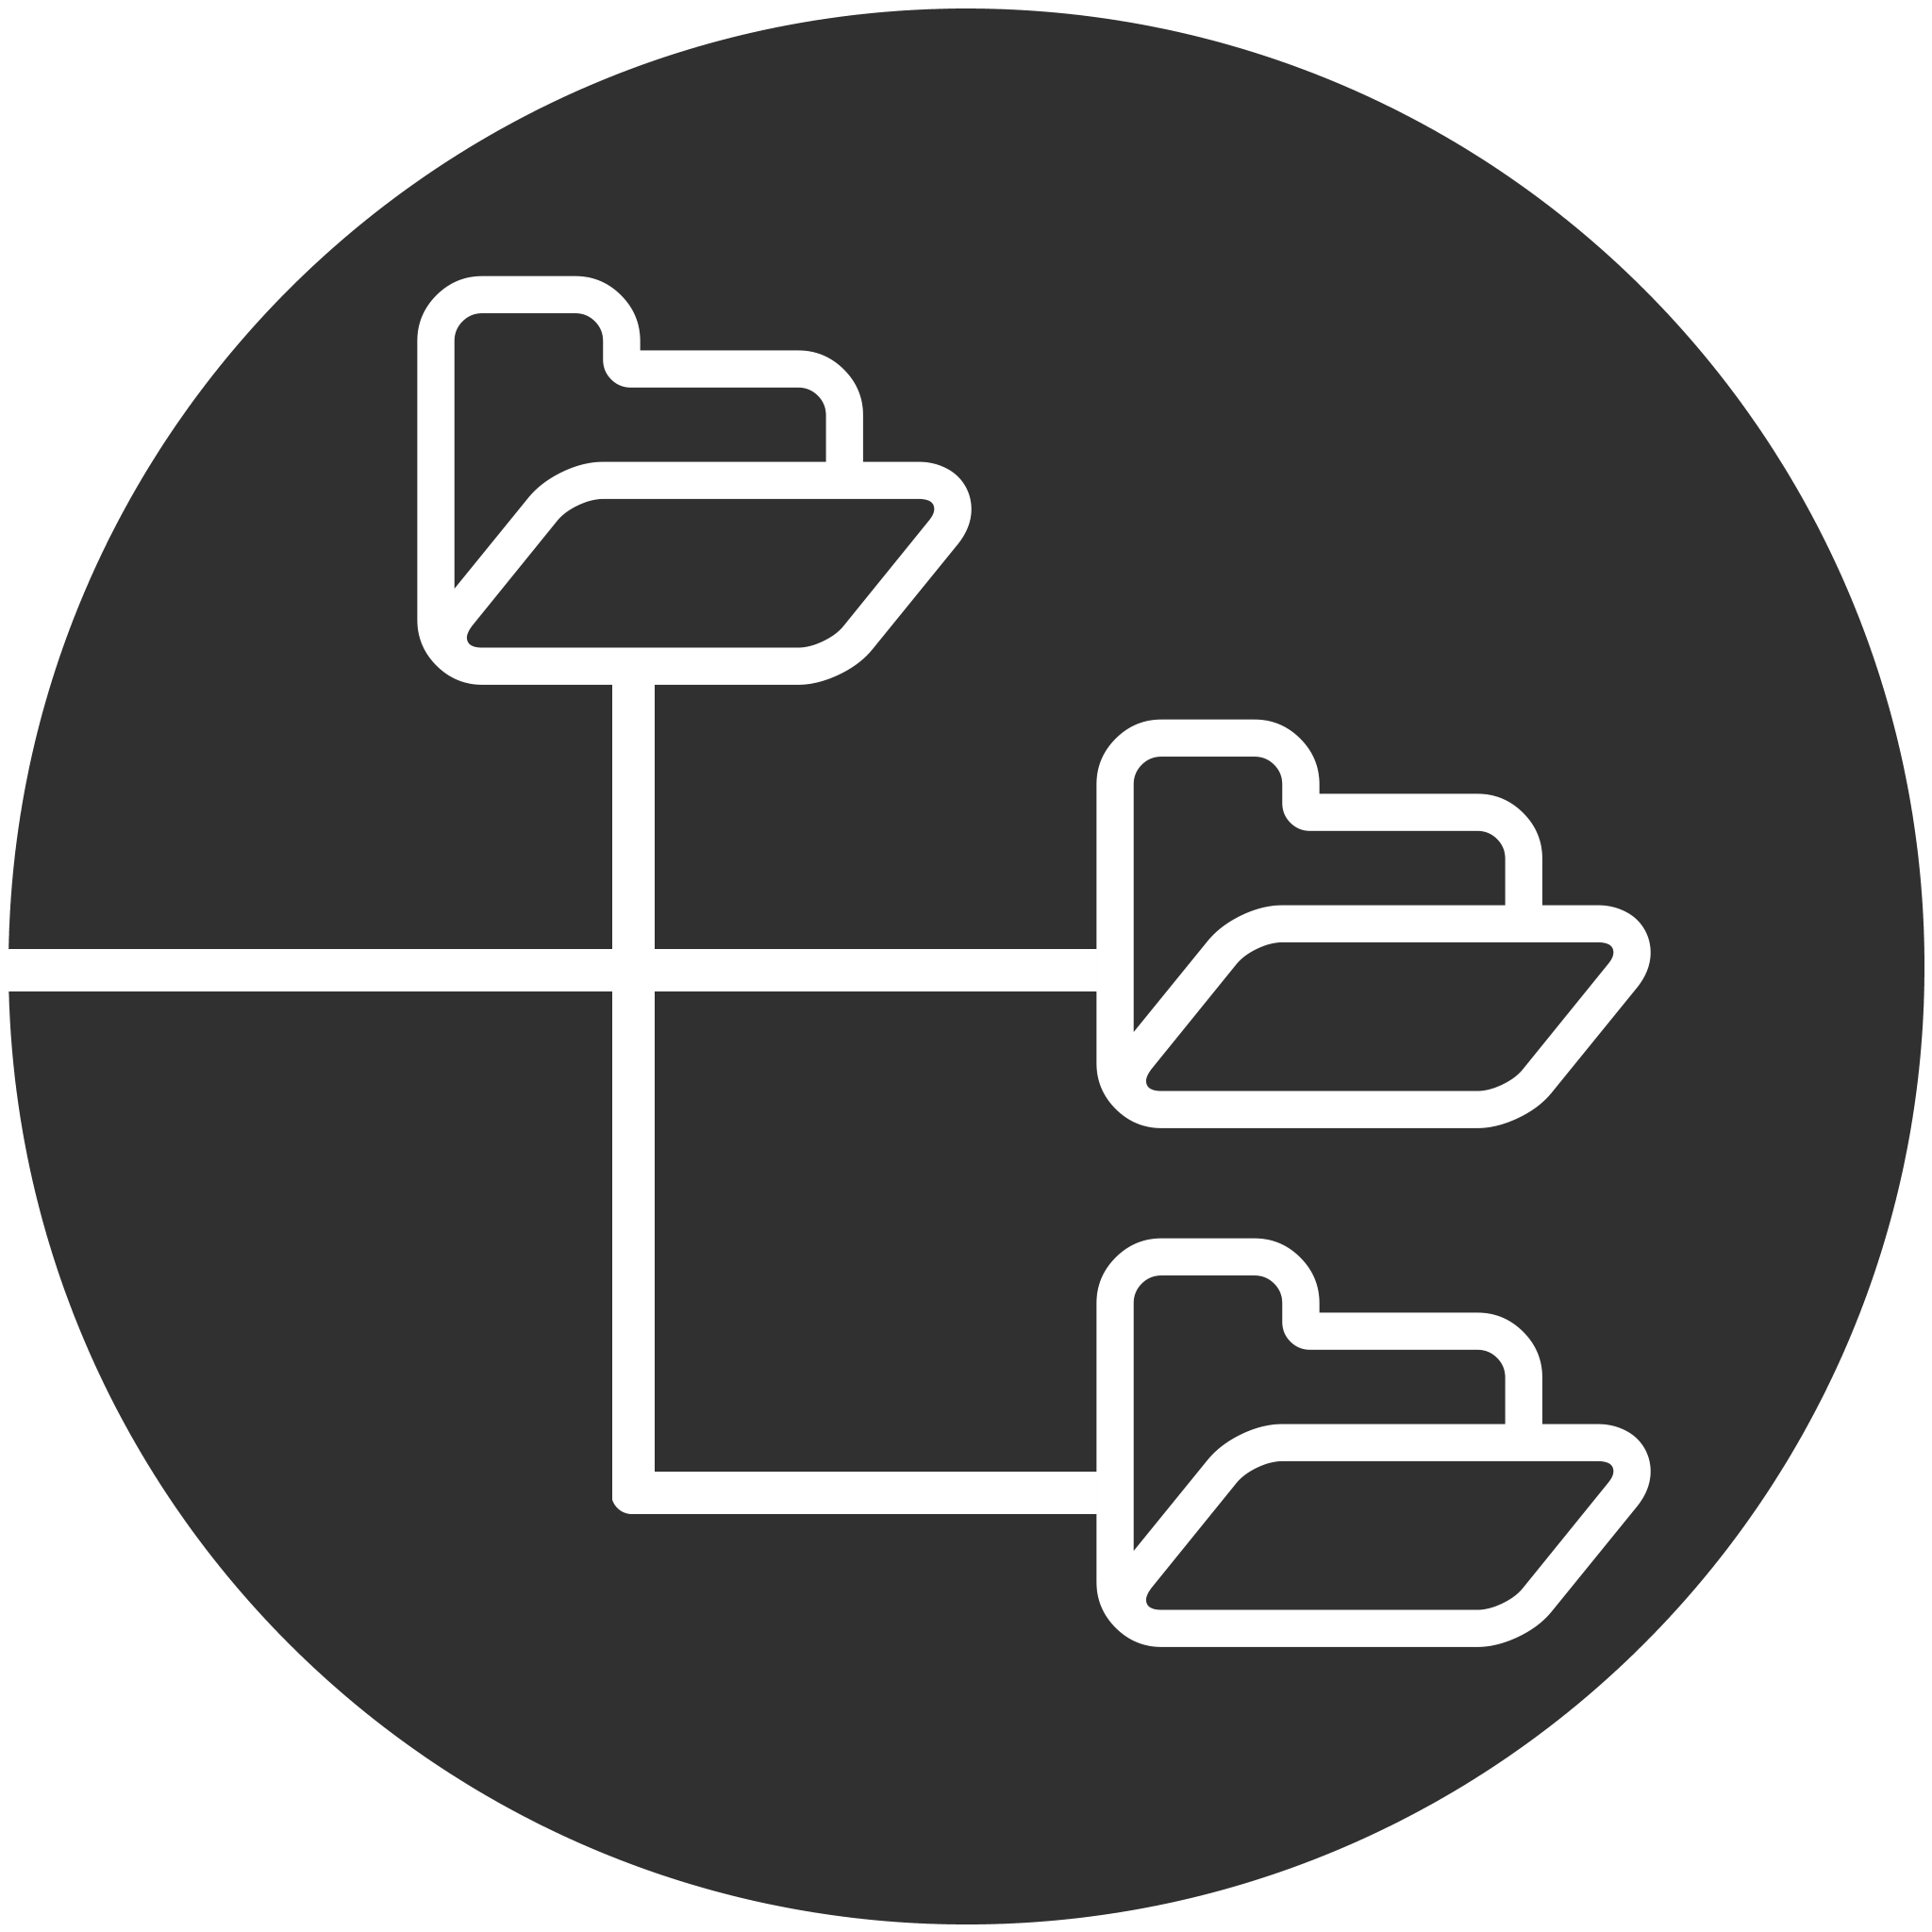
Current Technology
Notes:
[Colton]
30 seconds
Since their founding, they have used an off-the-cuff approach to project management using
Email to setup and update the projects
Microsoft Excel to track the projects
Microsoft Access database to archive the projects
Shared file system to store the documents of the projects

Slide 4
Project Workflow
Proposal
Federal agency starts inquiry to non-government contractor
Acceptance
Both parties sign and work begins
Termination
Parties end project. Final report is created
Drafting
Proposal is passed back and forth
Tracking
CPCESU tracks project including modifications
Reporting
Project archived and used for statistics and reporting
Notes:
[Remy]
45 seconds
= Using techs, this is their current project workflow at a glance<pause>
= First fed agency proposes a new project
= The contract is drafted and passed back and forth between fed, non-fed, and CPCESU till it is final
= Once the contract is signed by both fed and non-gov parties, work starts
= Our client tracks the project including any modifications
= Once a project is terminated, a final report is created by non-fed org and shared with fed agency and Colorado Plateau
= Lastly, the project is archived and used for reporting <end>

Slide 5
Problems
Proposal
Allow organizations to Submit proposals
Acceptance
Notify work has started
Termination
Archive projects
Drafting
Validate information on the contract
Tracking
Track and Modify projects
Reporting
Distribute information to management and public
Notes:
[Remy]
= From the current project management system, we have summarized the problems at each step
== Proposal stage --> organizations should submit inquiries directly into the new system
== During drafting → all information needs to be validated
== When accepted --> all parties should be notified auto.
== When the project is in-progress, tracking and modifications should be quick, easy, and efficient
== And when work is completed --> the project and its attachments should be archived and information distributed to the right people
= Overall tracking the projects, especially modifications, are the crux of our client’s problems
= Modifications are usually adding or removing time, money, and/or personnel
= The biggest problem is tens of millions of dollars going unreported due to bad tracking and reporting
= This can impact whether or not NAU wants to host the organization in the future
30 seconds
<end>

Slide 6
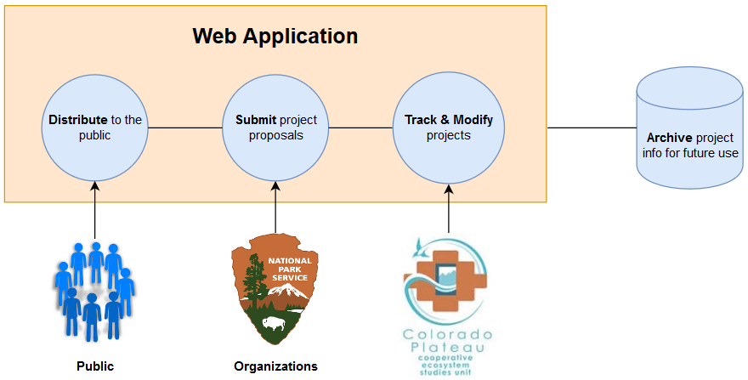
Solution - “Summit”
Archive
Distribute
Submit
Modify
Track
Notes:
[Colton]
30 seconds - 1 minute
The solution will be a secure web application built with Django with a PostgreSQL database that will track projects throughout their lifetime, archiving them when they are closed and disallowing edits to them
Hosted on its
Note web framework
!!!!!!!!!!!!!!!!!!!!!!!!!!!!!!Number the slides!!!!!!!!!!!!!!!!!!!!!
Key words to solve the various stakeholder problems
Where in solution addressing key works in previous slide
Should be clear in mapping the problem to the solution with keywords

Slide 7
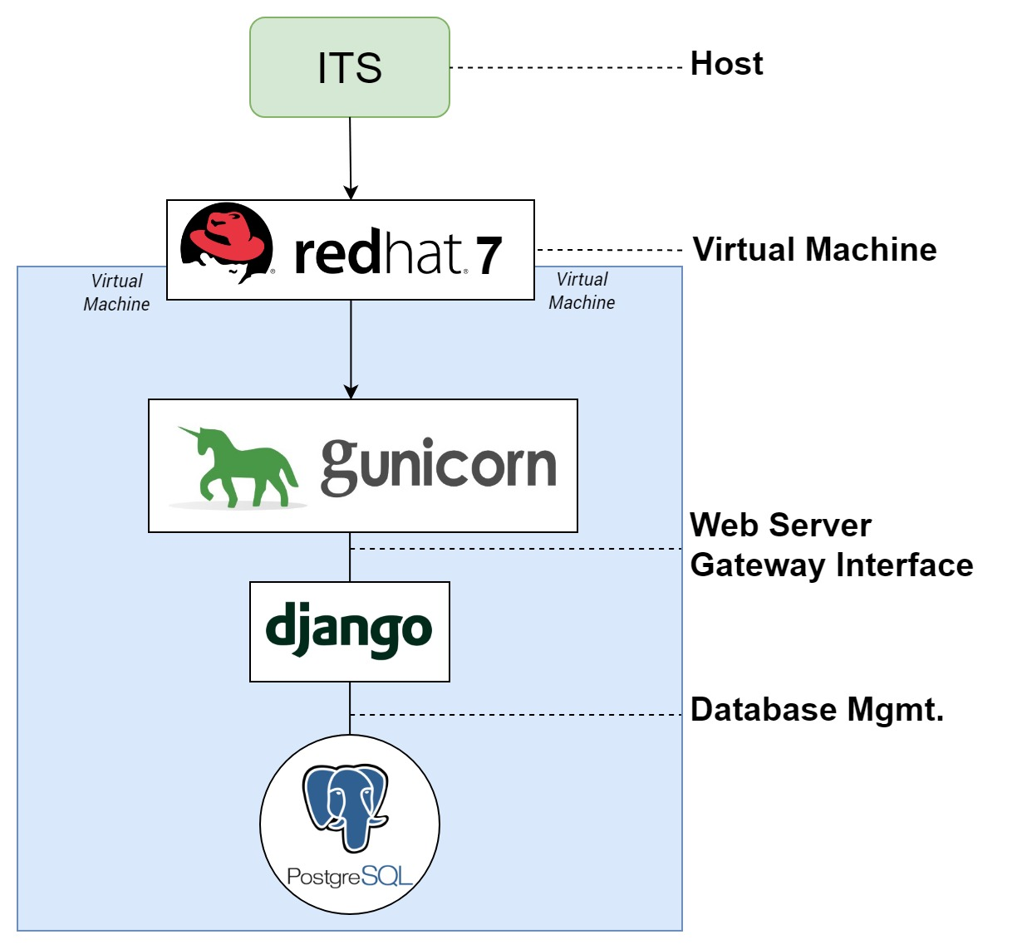
System Diagram
Notes:
[Colton]
30 seconds - 1 minute
Update diagram with new font

Slide 8
Elicitation Techniques
Passive
System Interface Analysis
User Interface Analysis
Document Analysis
Database Analysis
Active
Weekly Interviews
Observations
Notes:
[Jasque]

Slide 9
Key CPCESU Staff Requirements
As a CPCESU staffer, I want to track projects so that I understand, at a glance, what the project status is
SRS: UR.01
To be notified to review and approve of project modifications
To ensure correct data
To autofill from a document
To generate and export data from searches
Notes:
[Jasque]
As a <user type>, I want <some goal> so that <some reason>
I understand, at a glance, what the project status is
Database stays updated
common errors are not made
I don’t have to type in all of the data
I can inform organizations what they have done and to report to upper management

Slide 10
Key Organization/Public Requirements
Organization
Create a project
Make a modification to a project
Public
To search through CPCESU projects
To be able to use the website
Notes:
[Jasque]
As a <user type>, I want <some goal> so that <some reason>
it can be approved and edited by the CPCESU
I can find research that I am interested in
I can get involved with it

Slide 11
Top Level Functional Requirements
Projects shall be tracked through their six phases: Proposal, Drafting, Execution, Tracking, Termination, Archive
Options may have buttons large enough for users to click on with a slight shake, as defined in the following sections
SRS: F1.00
SRS: F2.00
Notes:
Data that is to be placed into the forms of the CPCESU Project Management System shall have to pass various parameters, as defined in following sections

Slide 12
Top Level Performance Requirements
The website shall take no more than 250 ms to respond to any user input, as defined in the following sections
SRS: P1.00
Secure
Intuitive
Notes:
[Jasque]
Secure benchmark no high risk and low # of low risk

Slide 13
Top Level Environmental Requirements
SRS: E1.01
Organizations have a variety of non-standard forms, thus SRS: F7.00 may not apply for all of these forms
Notes:
[Jasque]
Federal computers

Slide 14
Breakdown to Low Level Requirements
SRS: F2.00
Modifications to a project shall be tracked
When a modification is submitted by the organization, a CP Staff shall be notified of the modification
The CP staff shall approve or deny the modification
The result of this modification shall be logged
SRS: F2.01
SRS: F2.02
SRS: F2.03
Notes:
[Jasque]

Slide 15
Breakdown to Low Level Requirements
The CP staff shall approve or deny the modification
When approved, the modification shall be logged
See SRS: F2.03
When denied, the CP Staffer shall note a reason from a field or a custom one
Field entries are:
-
SRS: F2.02
SRS: F2.07
SRS: F2.08
Notes:
[Jasque]

Slide 16
Breakdown to Low Level Requirements
Modifications to a project shall be tracked
The CP staff shall approve or deny the modification
When denied, the CP Staffer notes a reason from a field or a custom one
Field entries are:
Improper paperwork
Notes:
[Jasque]

Slide 17
Risks and Feasibility
Learning curve too high | 25% | High
Overcome with CI/CD, early prototypes
Unknown or overlooked requirement | 10% | Mid to High
Procedures to modify the SRS after it is signed
Security breach | 5% | Mid to High
Overcome with security testing
Notes:
[Remy]
2 minutes tops - probably 1 minute
= With requirements and our tech feasibility, we have also gathered some risks
= The first is that curve is too high - 25% The potential impact = high → if this happens, our solution is not intuitive and our client may revert back.
== Use continuous integration and continuous delivery -> constantly release new versions
== Get feedback with early prototypes
= Next, common issue in software engineering is unknown or overlooked requirements - 10% - impact mid to high depending on the requirement level
== Procedures to modify the Software Requirements Specifications after it is signed
= Lastly, web app, can have security breach - 5% - mid to high → overcome with security testing
<End>

Slide 18
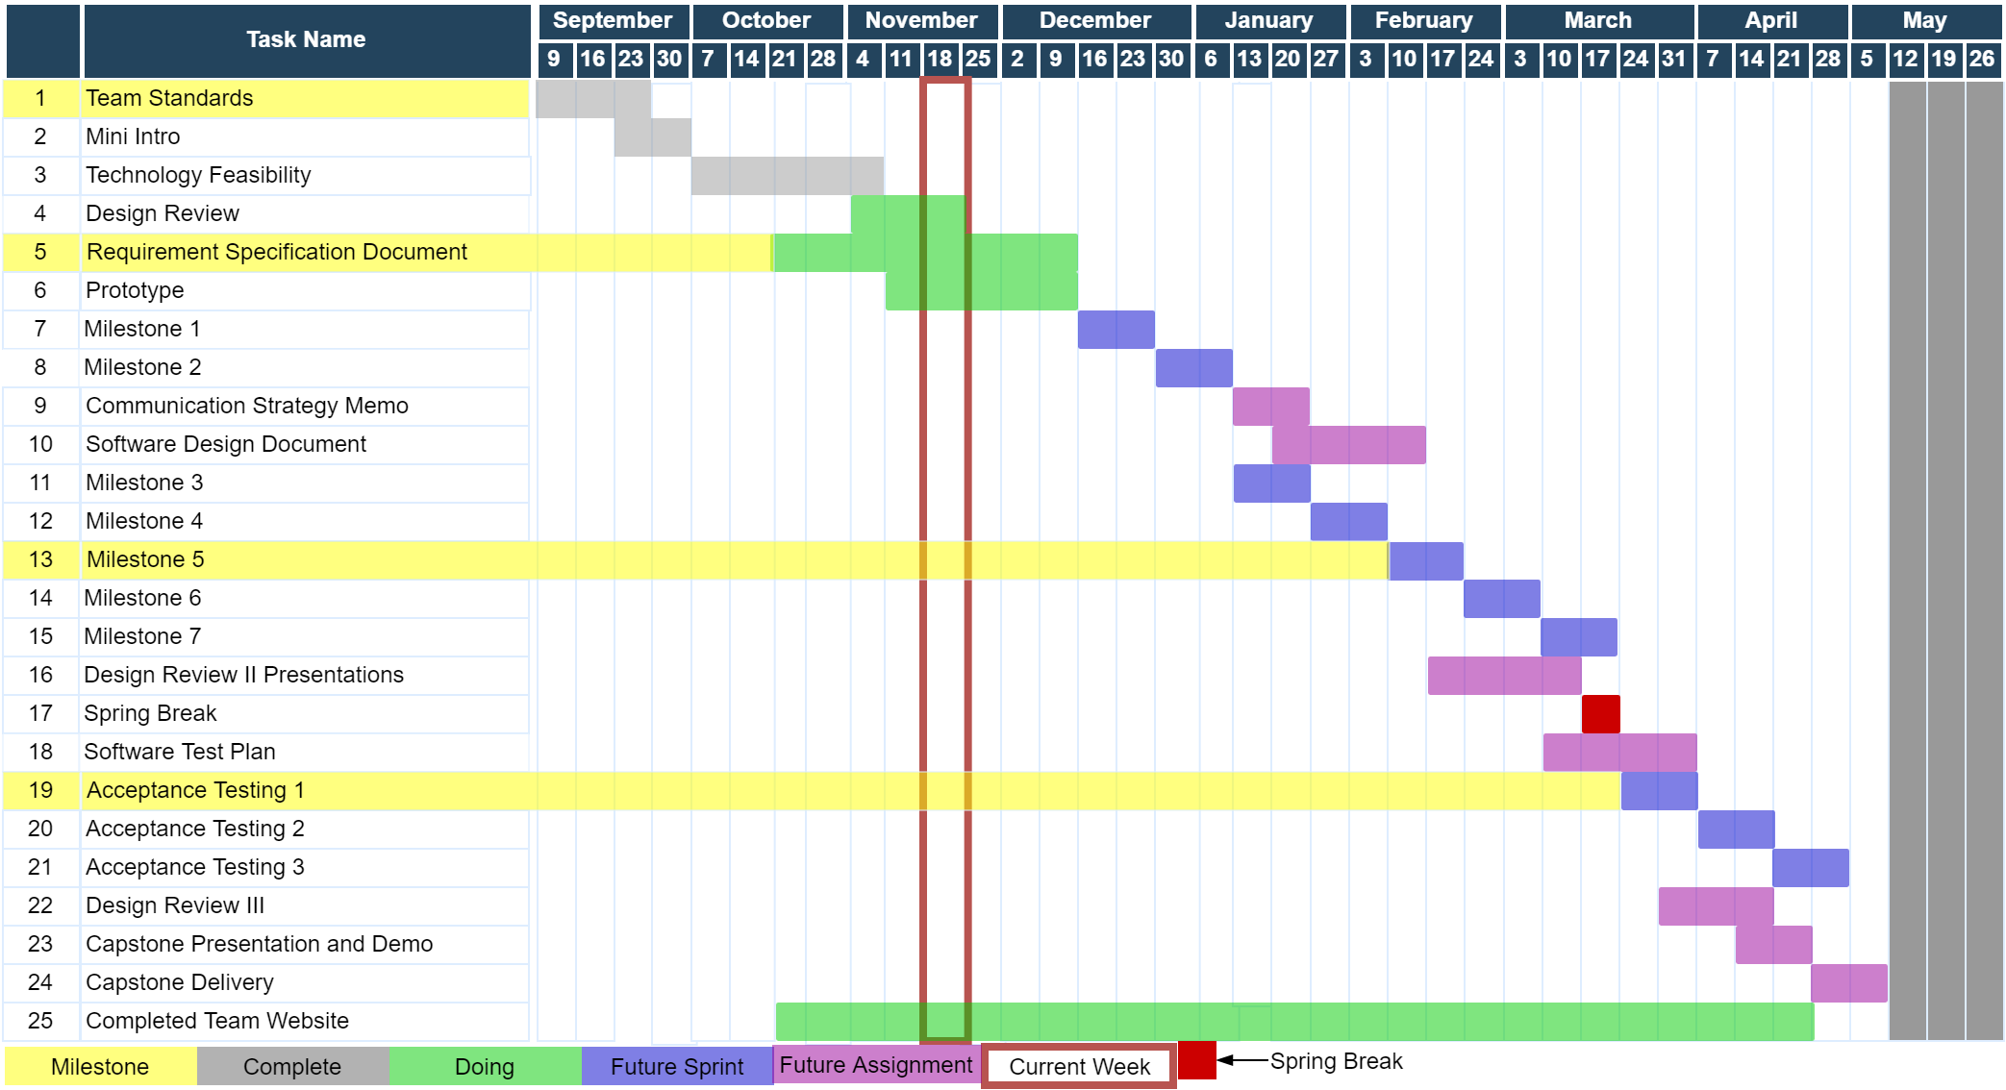
Year at a Glance
Notes:
[Remy]
1 minute to 1:30
= in red → this week
= in yellow → personal milestones
= on the left → are the previous previous tasks, completed in grey
= in the middle → in green, are the assignments we are currently working on
= on the right → are the future tasks.
== in blue, are planned sprint items
== in purple, are future capstone assignments
<end>
Gantt chart
Explain the chart better, resize the chart
Change color, red bad,
Use red to indicate maybe a problem atm
Color green where we are
Yellow what we are doing
Grey, yet to do
Red for dead/late
3 col, duration, start, end, not useful

Slide 19
Conclusion
Notes:
[Colton]
This can be rolled out to other CPCESU’s as they also have this same problem
1:30
Take opposite of intro, funnel out from solution, problem, cpcesu, to world impact
This may become national system
So as ECOders, we’re gonna provide the CPCESU with the ability to work on things that matter, such as project statistics, and predictions to help them with future projects. They shouldn’t be wasting their time on scouring an ad hoc database.
Project management system
Project reporting, querying, and statistics
Reduce paper waste
Decrease lost work hours
Uniformed system and processes
Validation of data

Slide 20
Broader Impacts
Better reporting to NAU and other organizations
Can become the national network’s system
Aiding conservation projects and the environment
Notes:
[Colton]
15 seconds
BROADER IMPACT TO THE REST OF CPCESU
This may become national system
So as ECOders, we’re gonna provide the CPCESU with the ability to work on things that matter, such as project statistics, and predictions to help them with future projects. They shouldn’t be wasting their time on scouring an ad hoc database.
Project management system
Project reporting, querying, and statistics
Reduce paper waste
Decrease lost work hours
Uniformed system and processes
Validation of data

Slide 21


CPCESU Project Management System
Joseph Remy | Colton Nunley | Jasque Saydyk
Team Lead Editor-in-Chief UI Designer Lead | Architect Customer Communications QA Manager | Business Analyst Recorder Release Manager
remy@nau.edu | crn79@nau.edu | jrs496@nau.edu
http://bit.ly/ECOders
Notes:
[Colton]
30 seconds top

Slide 22
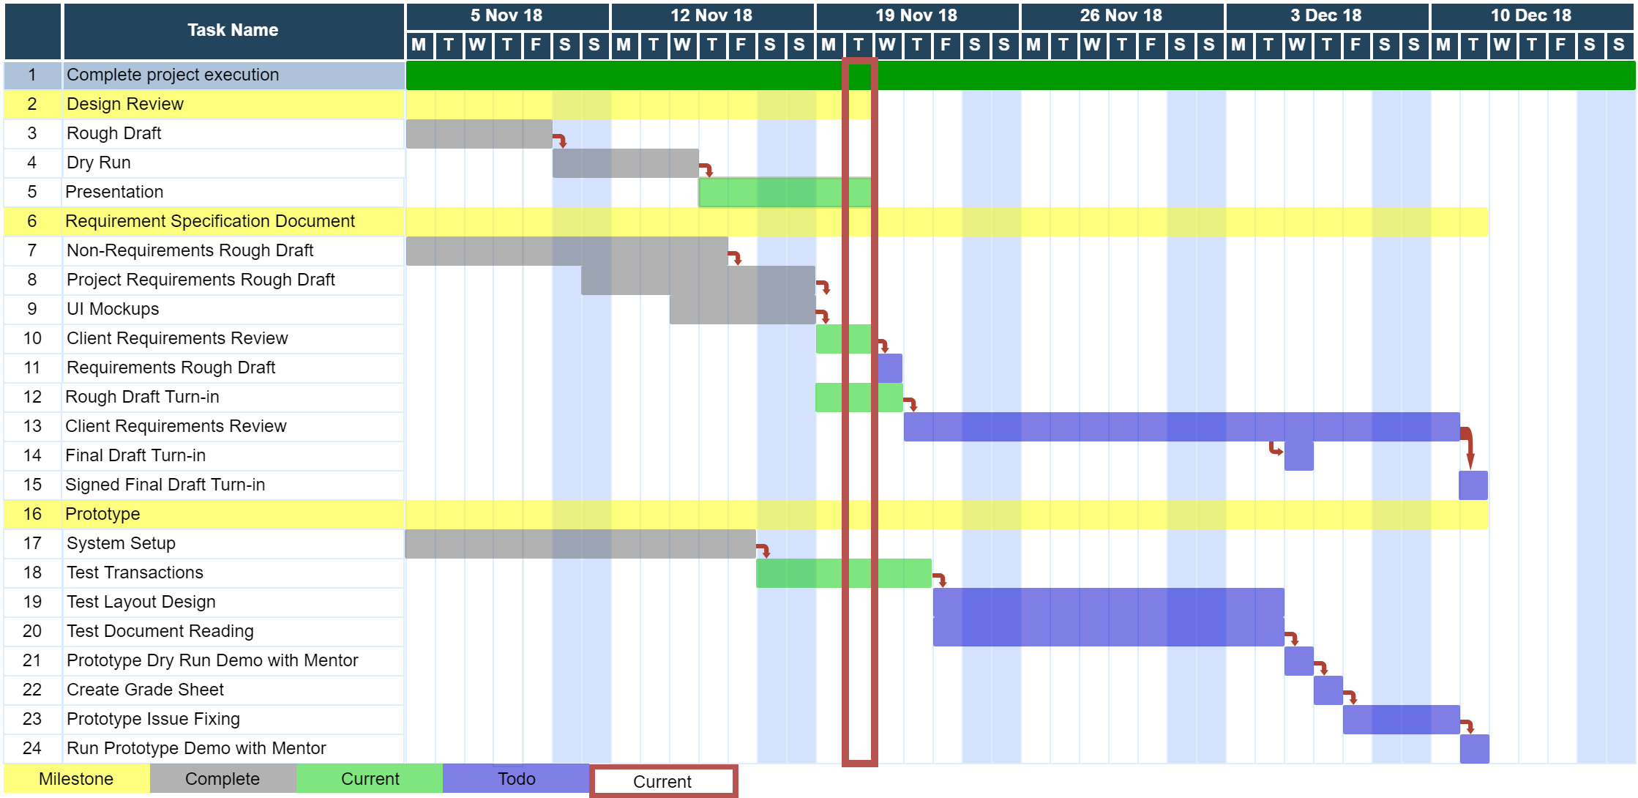
Fall Semester Schedule
Notes:
[Remy]
1 minute to 1:30
Gantt chart
Explain the chart better, resize the chart
Change color, red bad,
Use red to indicate maybe a problem atm
Color green where we are
Yellow what we are doing
Grey, yet to do
Red for dead/late
3 col, duration, start, end, not useful

